Slide 1
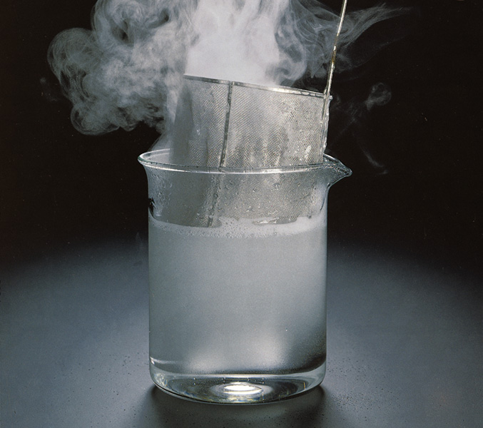
Chapter 15: Chemical Kinetics
General Chemistry
Principles and Modern Applications
Petrucci • Harwood • Herring
8th Edition
Philip Dutton
University of Windsor, Canada
N9B 3P4
Prentice-Hall © 2002

Slide 2
Contents
15-1 The Rate of a Chemical Reaction
15-2 Measuring Reaction Rates
15-3 Effect of Concentration on Reaction Rates: The Rate Law
15-4 Zero-Order Reactions
15-5 First-Order Reactions
15-6 Second-Order Reactions
15-7 Reaction Kinetics: A Summary

Slide 3
Contents
15-8 Theoretical Models for Chemical Kinetics
15-9 The Effect of Temperature on Reaction Rates
15-10 Reaction Mechanisms
15-11 Catalysis
Focus On Combustion and Explosions

Slide 4
15-1 The Rate of a Chemical Reaction
Rate of change of concentration with time.
2 Fe³⁺(aq) + Sn²⁺ → 2 Fe²⁺(aq) + Sn⁴⁺(aq)
t = 38.5 s [Fe²⁺] = 0.0010 M
Δt = 38.5 s Δ[Fe²⁺] = (0.0010 – 0) M
Δ[Fe²⁺]
0.0010 M
Rate of formation of Fe²⁺= = = 2.610⁻⁵ M s⁻¹
Δt
38.5 s

Slide 5
Rates of Chemical Reaction
2 Fe³⁺(aq) + Sn²⁺ → 2 Fe²⁺(aq) + Sn⁴⁺(aq)
Δ[Sn⁴⁺]
1
Δ[Fe²⁺]
1
Δ[Fe³⁺]
=
= -
Δt
2
Δt
2
Δt

Slide 6
General Rate of Reaction
a A + b B → c C + d D
Rate of reaction = rate of disappearance of reactants
1
Δ[A]
1
Δ[B]
= -
= -
a
Δt
b
Δt
= rate of appearance of products
1
Δ[C]
1
Δ[D]
=
=
c
Δt
d
Δt

Slide 7
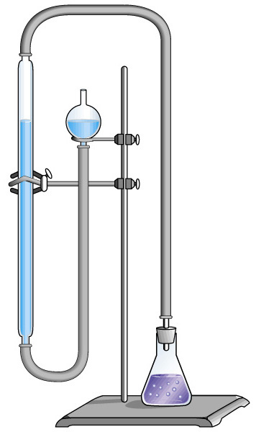
15-2 Measuring Reaction Rates
H₂O₂(aq) → H₂O(l) + ½ O₂(g)
2 MnO₄⁻(aq) + 5 H₂O₂(aq) + 6 H⁺ →
2 Mn²⁺ + 8 H₂O(l) + 5 O₂(g)
Notes:
3% H₂O₂ is a common antiseptic, its properties due to the release of O₂
Follow the reaction by monitoring O₂ or H₂O₂.
Remove aliquots and analyse for peroxide by titration.

Slide 8
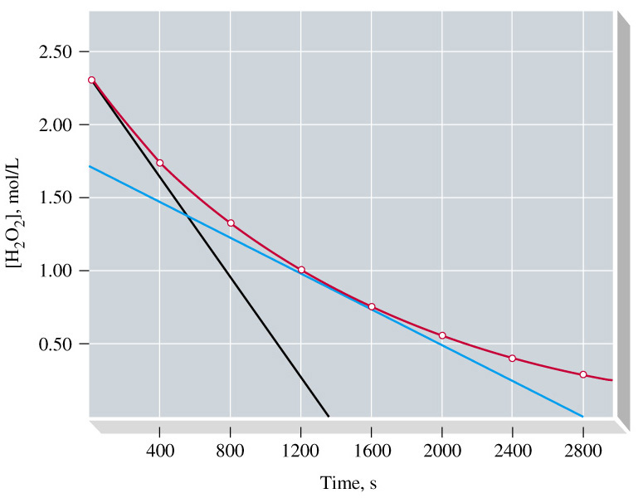
Example 15-2
Determining and Using an Initial Rate of Reaction.
H₂O₂(aq) → H₂O(l) + ½ O₂(g)
-Δ[H₂O₂]
-(-2.32 M / 1360 s) = 1.7  10⁻³ M s⁻¹
Rate =
Δt
-(-1.7 M / 2600 s) =
6  10⁻⁴ M s⁻¹
Notes:
Initial rate
Average rate over a time period.
Instantaneous rate – slope of tangent lin.

Slide 9
Example 15-2
What is the concentration at 100s?
- Δ[H₂O₂]
[H₂O₂]_{i} = 2.32 M
Rate = 1.7 10⁻³ M s⁻¹
=
Δt
-Δ[H₂O₂] = -([H₂O₂]_{f} - [H₂O₂]_{i})
= 1.7  10⁻³ M s⁻¹  Δt
[H₂O₂]_{100 s} – 2.32 M =
-1.7  10⁻³ M s⁻¹  100 s
[H₂O₂]_{100 s}
= 2.32 M - 0.17 M
= 2.17 M

Slide 10
15-3 Effect of Concentration on Reaction Rates: The Rate Law
a A + b B …. → g G + h H ….
Rate of reaction = k [A]^{m}[B]^{n ….}
Rate constant = k
Overall order of reaction = m + n + ….
Notes:
m and n are usually small whole numbers but may be fractional, negative or zero. They are often not related to a and b.
The larger k, the faster the reaction. k depends on temperature, concentration of catalyst and the specific reaction.

Slide 11
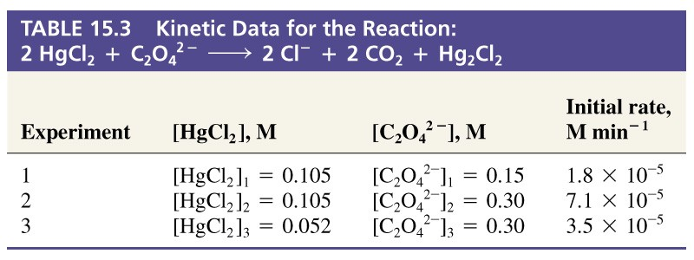
Example 15-3 Method of Initial Rates
Establishing the Order of a reaction by the Method of Initial Rates.
Use the data provided establish the order of the reaction with respect to HgCl₂ and C₂O₂²⁻ and also the overall order of the reaction.

Slide 12
Example 15-3
Notice that concentration changes between reactions are by a factor of 2.
Write and take ratios of rate laws taking this into account.

Slide 13
Example 15-3
R₃ = k[HgCl₂]₃^{m}[C₂O₄²⁻]₃^{n}
R₂ = k[HgCl₂]₂^{m}[C₂O₄²⁻]₂^{n}
= k(2[HgCl₂]₃)^{m}[C₂O₄²⁻]₃^{n}
R₂
k(2[HgCl₂]₃)^{m}[C₂O₄²⁻]₃^{n}
=
R₃
k[HgCl₂]₃^{m}[C₂O₄²⁻]₃^{n}
R₂
k2^{m}[HgCl₂]₃^{m}[C₂O₄²⁻]₃^{n}
2^{m}R₃
=
=
= 2.0
R₃
k[HgCl₂]₃^{m}[C₂O₄²⁻]₃^{n}
R₃
2^{m} = 2.0 therefore m = 1.0

Slide 14
Example 15-3
R₂ = k[HgCl₂]₂¹[C₂O₄²⁻]₂^{n} = k(0.105)(0.30)^{n}
R₁ = k[HgCl₂]₁¹[C₂O₄²⁻]₁^{n} = k(0.105)(0.15)^{n}
R₂
k(0.105)(0.30)^{n}
=
R₁
k(0.105)(0.15)^{n}
R₂
(0.30)^{n}
7.110⁻⁵
=
= 2^{n} =
= 3.94
R₁
(0.15)^{n}
1.810⁻⁵
2^{n} = 3.98 therefore n = 2.0

Slide 15
Example 15-3
1
2
R₂ = k[HgCl₂]₂ [C₂O₄²⁻]₂
First order
+ = Third Order
Second order

Slide 16
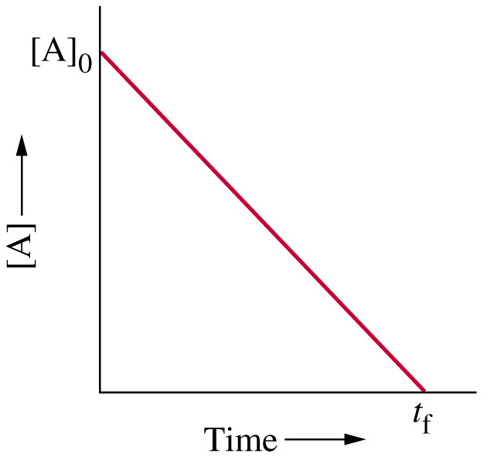
15-4 Zero-Order Reactions
A → products
R_{rxn} = k [A]⁰
R_{rxn} = k
[k] = mol L⁻¹ s⁻¹

Slide 17
Integrated Rate Law
-Δ[A]
Move to the
infinitesimal
-d[A]
= k
= k
Δt
dt
And integrate from 0 to time t
[A]_{t}
t
-
d[A]

= k
dt
[A]₀
0
-[A]_{t} + [A]₀ = kt
[A]_{t} = [A]₀ - kt

Slide 18
15-5 First-Order Reactions
H₂O₂(aq) → H₂O(l) + ½ O₂(g)
d[H₂O₂ ]
= -k [H₂O₂]
[k] = s⁻¹
dt
[A]_{t}
d[H₂O₂ ]
t


= - k dt
[H₂O₂]
[A]₀
0
[A]_{t}
ln
= -kt
ln[A]_{t} = -kt + ln[A]₀
[A]₀
Notes:
You can tell the units of the rate constant by looking at the integrated rate law. Logarithms are unit-less so kt must have no units.

Slide 19
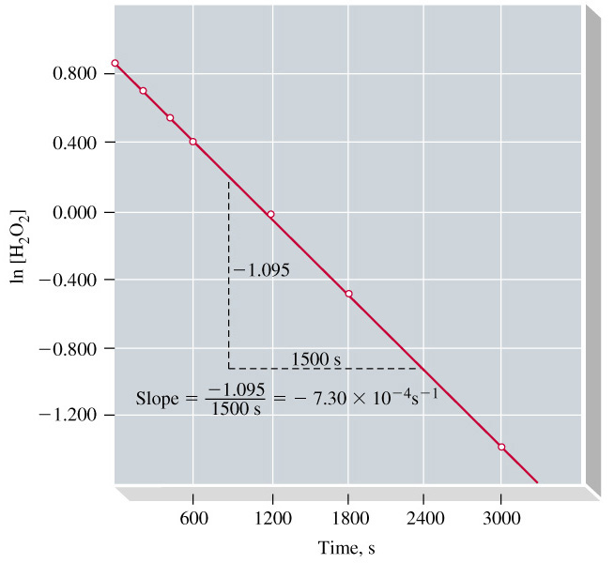
First-Order Reactions
Notes:
Simple test of second order is to plot ln [reactant] vs time and see if the graph is linear.

Slide 20
Half-Life
t_{½} is the time taken for one-half of a reactant to be consumed.
[A]_{t}
ln
= -kt
[A]₀
½[A]₀
ln
= -kt_{½}
[A]₀
- ln 2 = -kt_{½}
ln 2
0.693
t_{½} =
=
k
k
Notes:
The half-life for a first order reaction is constant and independent of the initial concentration.

Slide 21
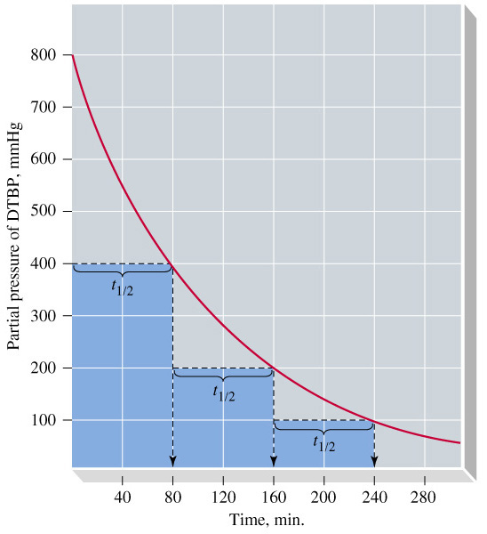
Half-Life
Bu^{t}OOBu^{t}(g) → 2 CH₃CO(g) + C₂H₄(g)

Slide 22
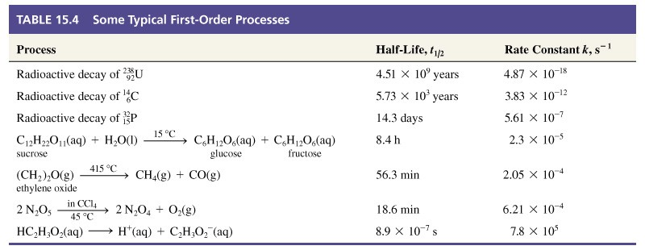
Some Typical First-Order Processes

Slide 23
15-6 Second-Order Reactions
Rate law where sum of exponents m + n +… = 2.
A → products
d[A]
= -k[A]²
[k] = M⁻¹ s⁻¹ = L mol⁻¹ s⁻¹
dt
[A]_{t}
d[A]
t


= - k
dt
[A]²
[A]₀
0
1
1
= kt +
[A]_{t}
[A]₀
Notes:
Limit the discussion to the decomposition of a single reactant that follows second order kinetics.

Slide 24
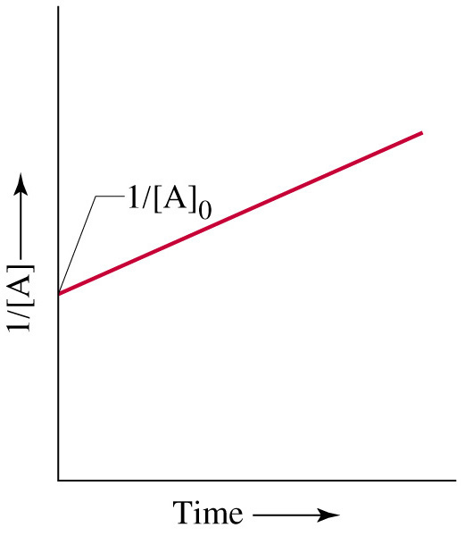
Second-Order Reaction

Slide 25
Pseudo First-Order Reactions
Simplify the kinetics of complex reactions
Rate laws become easier to work with.
CH₃CO₂C₂H₅ + H₂O → CH₃CO₂H + C₂H₅OH
If the concentration of water does not change appreciably during the reaction.
  Rate law appears to be first order.
Typically hold one or more reactants constant by using high concentrations and low concentrations of the reactants under study.

Slide 26
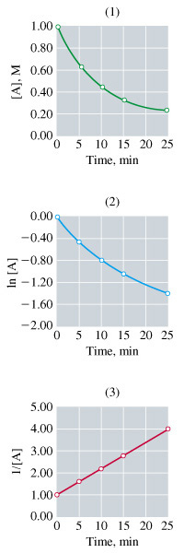
Testing for a Rate Law
Plot [A] vs t.
Plot ln[A] vs t.
Plot 1/[A] vs t.

Slide 27
15-7 Reaction Kinetics: A Summary
Calculate the rate of a reaction from a known rate law using:
Determine the instantaneous rate of the reaction by:
Rate of reaction = k [A]^{m}[B]^{n ….}
Finding the slope of the tangent line of [A] vs t or,
Evaluate –Δ[A]/Δt, with a short Δt interval.

Slide 28
Summary of Kinetics
Determine the order of reaction by:
Using the method of initial rates.
Find the graph that yields a straight line.
Test for the half-life to find first order reactions.
Substitute data into integrated rate laws to find the rate law that gives a consistent value of k.

Slide 29
Summary of Kinetics
Find the rate constant k by:
Find reactant concentrations or times for certain conditions using the integrated rate law after determining k.
Determining the slope of a straight line graph.
Evaluating k with the integrated rate law.
Measuring the half life of first-order reactions.

Slide 30
15-8 Theoretical Models for
Chemical Kinetics
Collision Theory
Kinetic-Molecular theory can be used to calculate the collision frequency.
  In gases 10³⁰ collisions per second.
  If each collision produced a reaction, the rate would be about 10⁶ M s⁻¹.
  Actual rates are on the order of 10⁴ M s⁻¹.
    Still a very rapid rate.
  Only a fraction of collisions yield a reaction.

Slide 31
Activation Energy
For a reaction to occur there must be a redistribution of energy sufficient to break certain bonds in the reacting molecule(s).
Activation Energy is:
  The minimum energy above the average kinetic energy that molecules must bring to their collisions for a chemical reaction to occur.

Slide 32
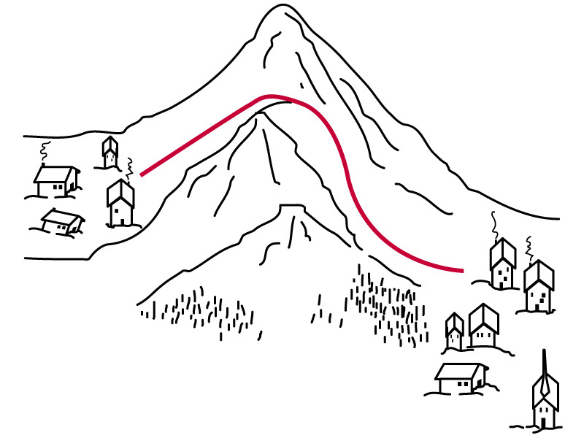
Activation Energy

Slide 33
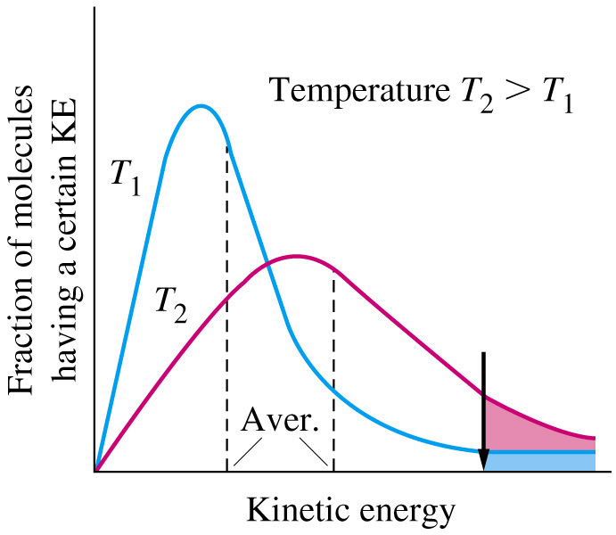
Kinetic Energy

Slide 34
Collision Theory
If activation barrier is high, only a few molecules have sufficient kinetic energy and the reaction is slower.
As temperature increases, reaction rate increases.
Orientation of molecules may be important.

Slide 35
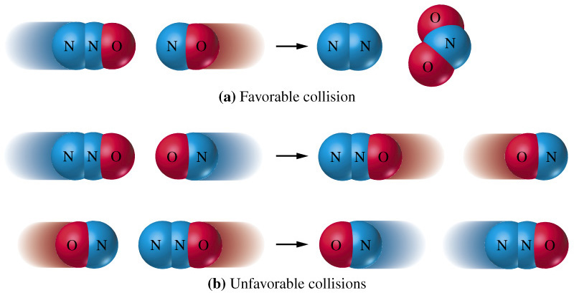
Collision Theory

Slide 36
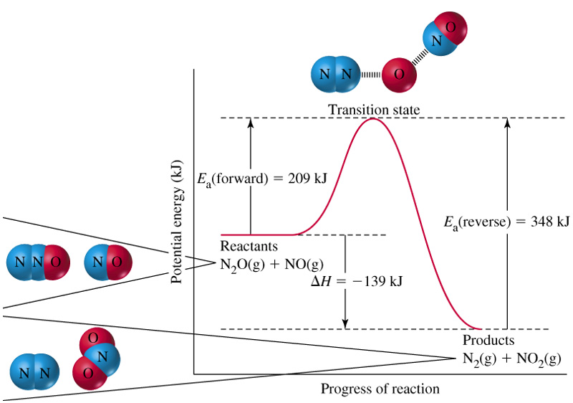
Transition State Theory
The activated complex is a hypothetical species lying between reactants and products at a point on the reaction profile called the transition state.

Slide 37
15-9 Effect of Temperature on
Reaction Rates
Svante Arrhenius demonstrated that many rate constants vary with temperature according to the equation:
k = Ae^{-Ea/RT}
-Ea
1
ln k = + ln A
R
T

Slide 38
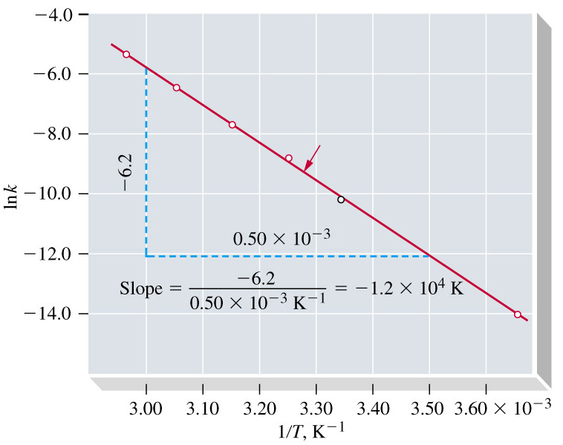
Arrhenius Plot
N₂O₅(CCl₄) → N₂O₄(CCl₄) + ½ O₂(g)
-E_{a}
= -1.210⁴ K
R
-E_{a} = 1.010² kJ mol⁻¹

Slide 39
Arrhenius Equation
-E_{a}
1
k = Ae^{-Ea/RT}
ln k = + ln A
R
T
-E_{a}
1
-E_{a}
1
ln k₂– ln k₁ = + ln A - - ln A
R
T₂
R
T₁
k₁
-E_{a}
1
1
ln = -
k₂
R
T₂
T₁

Slide 40
15-10 Reaction Mechanisms
A step-by-step description of a chemical reaction.
Each step is called an elementary process.
  Any molecular event that significantly alters a molecules energy of geometry or produces a new molecule.
Reaction mechanism must be consistent with:
  Stoichiometry for the overall reaction.
  The experimentally determined rate law.

Slide 41
Elementary Processes
Unimolecular or bimolecular.
Exponents for concentration terms are the same as the stoichiometric factors for the elementary process.
Elementary processes are reversible.
Intermediates are produced in one elementary process and consumed in another.
One elementary step is usually slower than all the others and is known as the rate determining step.
Notes:
Termolecular reactions are rare.
Concentration term exponents are unlikely to be the stoichiometric factors for the overall rate law.
Equilibrium may be attained.
Intermediates do not appear in the overall chemical equation or the rate law.

Slide 42
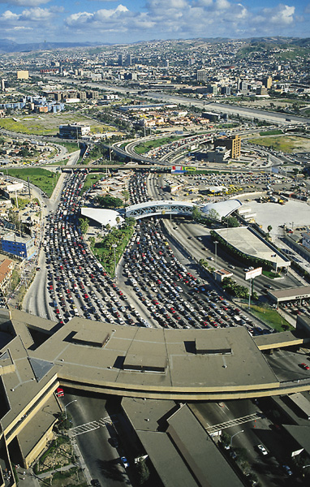
A Rate Determining Step

Slide 43
Slow Step Followed by a Fast Step
d[P]
H₂(g) + 2 ICl(g) → I₂(g) + 2 HCl(g)
= k[H₂][ICl]
dt
Postulate a mechanism:
d[HI]
slow
= k[H₂][ICl]
H₂(g) + ICl(g) HI(g) + HCl(g)
dt
fast
d[I₂]
HI(g) + ICl(g) I₂(g) + HCl(g)
= k[HI][ICl]
dt
d[P]
H₂(g) + 2 ICl(g) → I₂(g) + 2 HCl(g)
= k[H₂][ICl]
dt

Slide 44
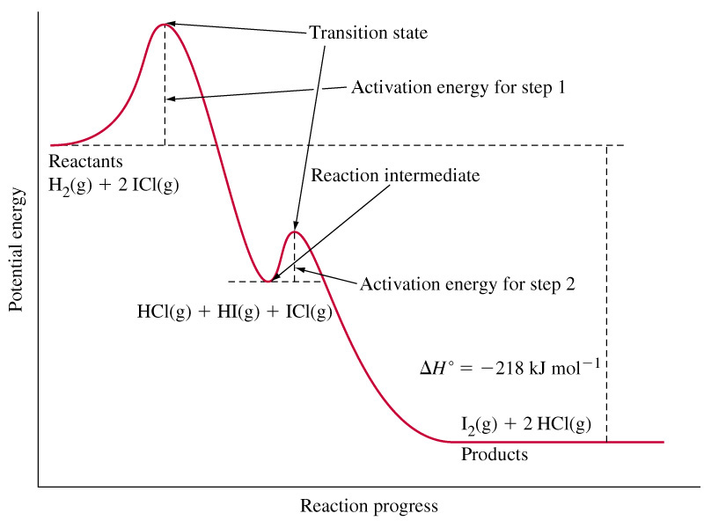
Slow Step Followed by a Fast Step

Slide 45
Fast Reversible Step Followed by a Slow Step
d[P]
2NO(g) + O₂(g) → 2 NO₂(g)
= -k_{obs}[NO₂]²[O₂]
dt
Postulate a mechanism:
k₁
k₁
2NO(g)  N₂O₂(g)
[N₂O₂]
=
[NO]²
= K [NO]²
fast
k₋₁
k₋₁
k₁
[N₂O₂]
K =
=
k₋₁
[NO]
k₂
d[NO₂]
slow
N₂O₂(g) + O₂(g) 2NO₂(g)
= k₂[N₂O₂][O₂]
dt
d[I₂]
k₁
2NO(g) + O₂(g) → 2 NO₂(g)
= k₂ [NO]²[O₂]
dt
k₋₁

Slide 46
The Steady State Approximation
k₁
k₁
2NO(g) N₂O₂(g)
2NO(g) N₂O₂(g)
k₋₁
k₂
2NO(g) N₂O₂(g)
N₂O₂(g) 2NO(g)
k₃
k₃
N₂O₂(g) + O₂(g) 2NO₂(g)
N₂O₂(g) + O₂(g) 2NO₂(g)
d[NO₂]
= k₃[N₂O₂][O₂]
dt
d[N₂O₂]
= k₁[NO]² – k₂[N₂O₂] – k₃[N₂O₂][O₂] = 0
dt

Slide 47
The Steady State Approximation
d[N₂O₂]
= k₁[NO]² – k₂[N₂O₂] – k₃[N₂O₂][O₂] = 0
dt
k₁[NO]² = [N₂O₂](k₂ + k₃[O₂])
k₁[NO]²
[N₂O₂] =
(k₂ + k₃[O₂])
d[NO₂]
k₁k₃[NO]²[O₂]
= k₃[N₂O₂][O₂]
=
dt
(k₂ + k₃[O₂])

Slide 48
Kinetic Consequences of Assumptions
k₁
2NO(g) N₂O₂(g)
d[NO₂]
k₁k₃[NO]²[O₂]
k₂
=
N₂O₂(g) 2NO(g)
dt
(k₂ + k₃[O₂])
k₃
N₂O₂(g) + O₂(g) 2NO₂(g)
d[NO₂]
k₁k₃[NO]²[O₂]
Let k₂ << k₃
=
k₁[NO]²
=
dt
( k₃[O₂])
Or
d[NO₂]
k₁k₃[NO]²[O₂]
k₁k₃
Let k₂ >> k₃
=
=
[NO]²[O₂]
dt
( k₂)
k₂

Slide 49
11-5 Catalysis
Alternative reaction pathway of lower energy.
Homogeneous catalysis.
  All species in the reaction are in solution.
Heterogeneous catalysis.
  The catalyst is in the solid state.
  Reactants from gas or solution phase are adsorbed.
  Active sites on the catalytic surface are important.

Slide 50
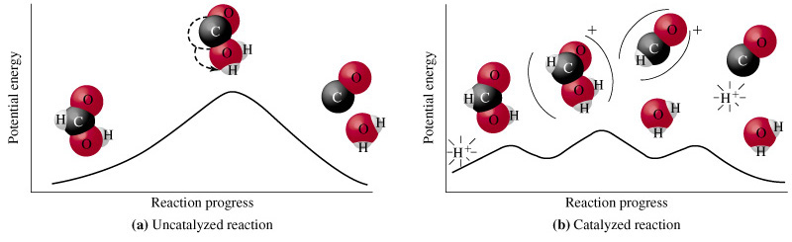
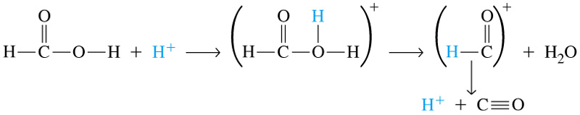
11-5 Catalysis

Slide 51
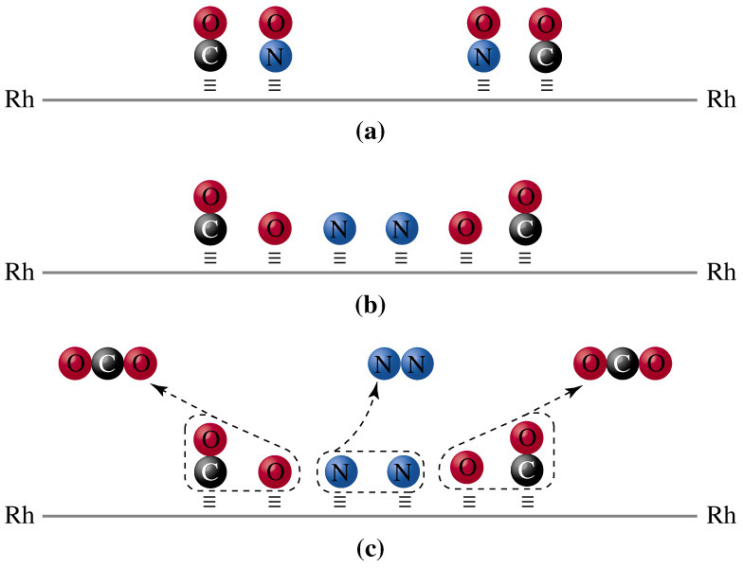
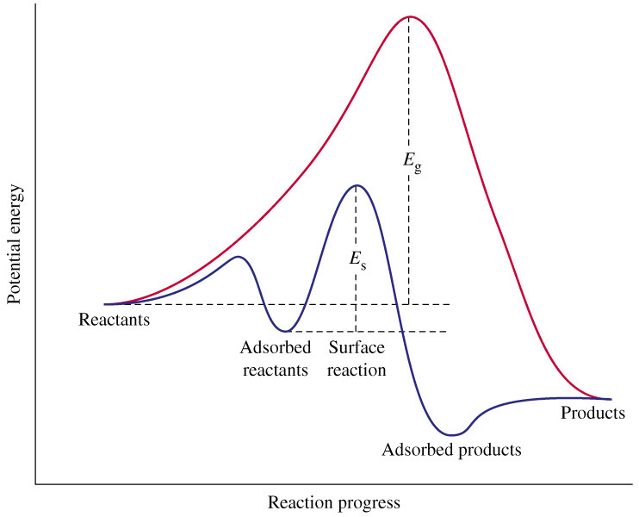
Catalysis on a Surface

Slide 52
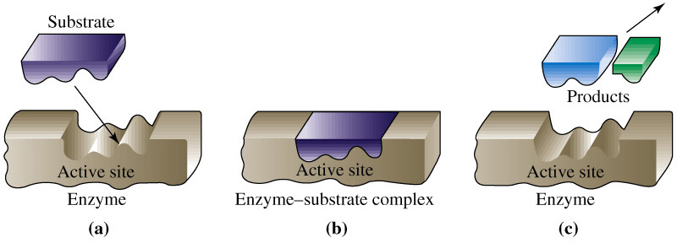
Enzyme Catalysis
k₁
k₂
E + S  ES
ES → E + P
k₋₁

Slide 53
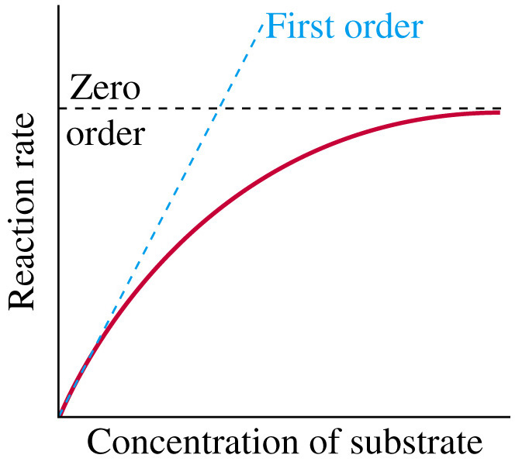
Saturation Kinetics
k₁
d[P]
k₂
= k₂[ES]
E + S  ES
→ E + P
k₋₁
dt
d[P]
= k₁[E][S] – k₋₁[ES] – k₂[ES]= 0
dt
k₁[E][S] = (k₋₁+k₂ )[ES]
[E] = [E]₀ – [ES]
k₁[S]([E]₀ –[ES]) = (k₋₁+k₂ )[ES]
k₁[E]₀ [S]
[ES] =
(k₋₁+k₂ ) + k₁[S]

Slide 54
Michaelis-Menten
d[P]
k₁k₂[E]₀ [S]
=
dt
(k₋₁+k₂ ) + k₁[S]
d[P]
d[P]
k₂[E]₀ [S]
=
k₂[E]₀
=
dt
dt
(k₋₁+k₂ ) + [S]
k₁
d[P]
k₂
d[P]
k₂[E]₀ [S]
=
[E]₀ [S]
=
dt
K_{M}
dt
K_{M} + [S]

Slide 55
Chapter 15 Questions
Develop problem solving skills and base your strategy not on solutions to specific problems but on understanding.
Choose a variety of problems from the text as examples.
Practice good techniques and get coaching from people who have been here before.

